Slide 1
Rajshahi Mohila Polytechnic Institute, Rajshahi.
CST 7th Semester 2nd shift
Project Name: E-commerce Website

Slide 2
What is Django?
Django is a web application framework written in Python programming language. Django helps eliminate repetitive tasks making the development process an easy and time saving experience.

Slide 3
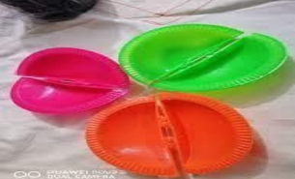

What is Framework?

Slide 4
How to Django Works?
Django is based on MVT architecture. MVT is a software design pattern for developing a web application.
M V T
Model View Template

Slide 5
What is MVT?
❑ Model: This is an abstraction layer for structuring and manipulating the data of the Web Application. It acts as an interface for maintaining data. This is a logical data structure behind the entire application and helps to handle the database.
❑ View: This layer encapsulates the logic responsible for processing a user’s request and returns a response. It is a user interface to execute the logic and interact with the models. It is responsible for displaying all or a portion of data to the user.
❑ Template: The template layer provides a designer-friendly syntax for rendering the information to be presented to the user. It contains the static parts of the desired HTML output along with some special syntax, also known as Django Template Language (DTL).

Slide 6
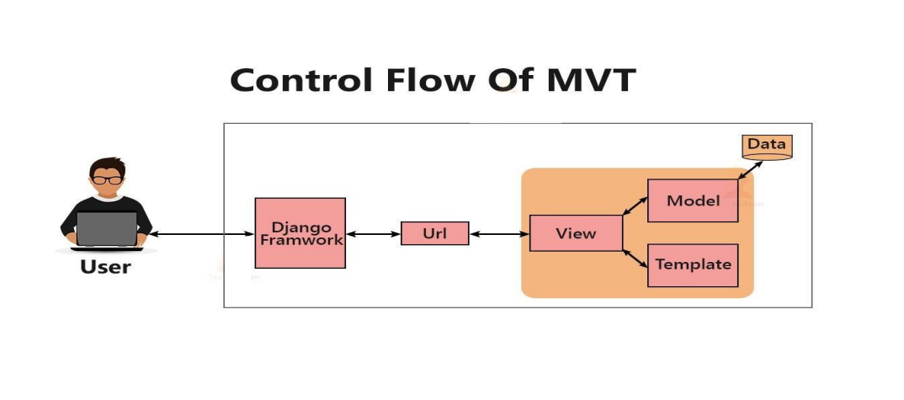
MVT Structure?

Slide 7
Environment Setup
❑ Visual Studio Code Install
❑ Extension Install inside Vs code.

Slide 8
How to Create Project & App
❑ Project: django-admin startproject project_name
❑ App: python manage.py startapp app_name

Slide 9
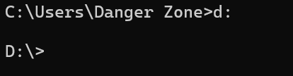
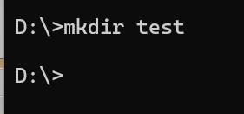
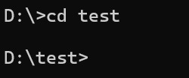
Create a directory/folder from CMD:
Change drive: drive name(:) exp- d: (enter)
Cmd: mkdir (folder name)
change directory: cd (folder name)

Slide 10
Virtual environment Create.
Virtual Environment Create:
Command cmd: python –m venv env (name)
Terminal New Terminal Command Prompt
Then, Env Script (Active) click and drop (Enter).

Slide 11
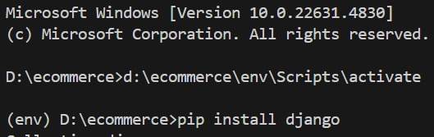
Django Installation:
Command : (env) D:\ecommerce>pip install Django (Enter)

Slide 12


Project create commad
Command (cmd): django-admin startproject (Project Name) then enter
*Go to the Project: cd (Project Name)

Slide 13
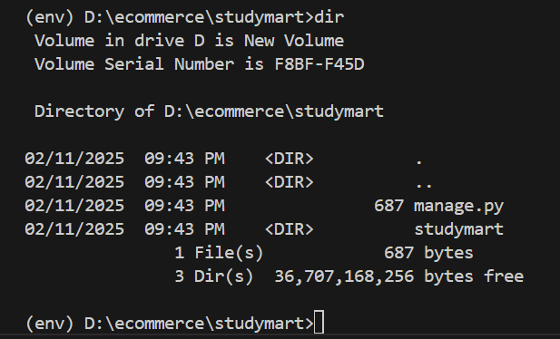
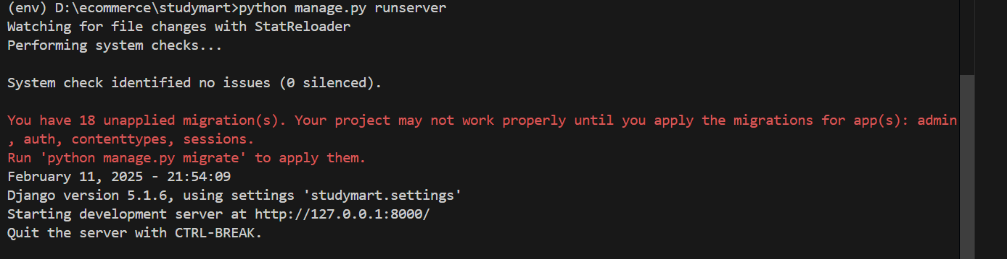
Django Project Run
Current Location check: dir (Enter)
Django Project run cmd: python manage.py runserver (url: http://127.0.0.1:8000/)

Slide 14
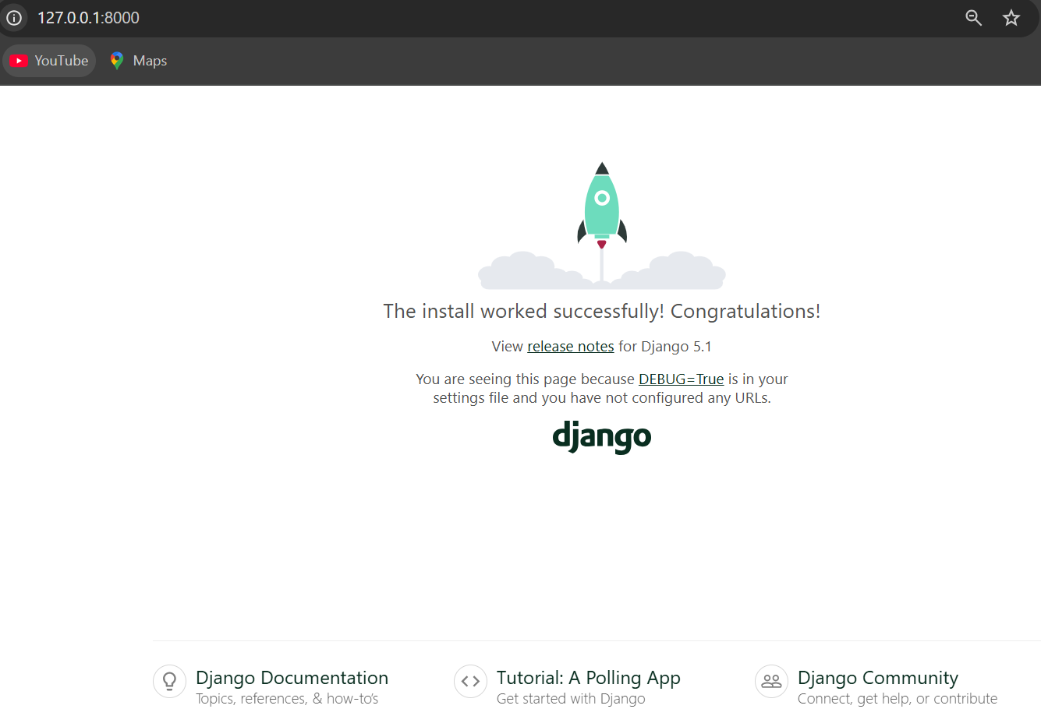
Django project installation successful…

Slide 15
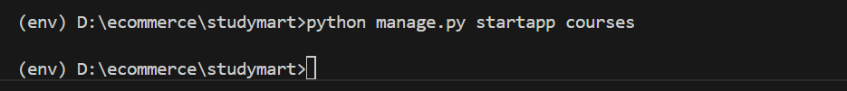
App create
App create command: cmd- python manage.py startapp (app name)
Again project run: python manage.py runserver

Slide 16
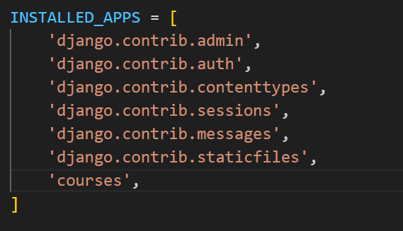
App connect with main project:
Innter Project (Studymart)- Settings.py- Installed_app

Slide 17
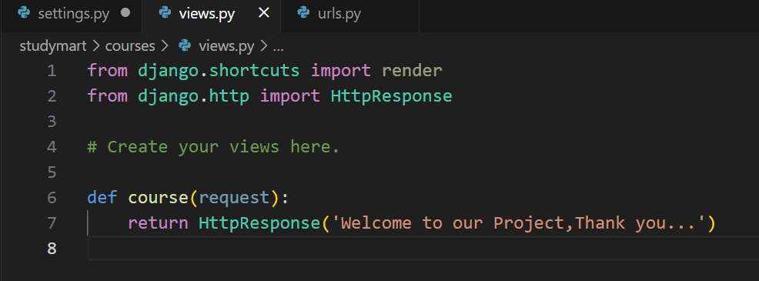
Output check:
Go to views.py- import - (from django.http import HttpResponse)
def course(request):
return HttpResponse('Welcome to our Project,Thank you...')

Slide 18
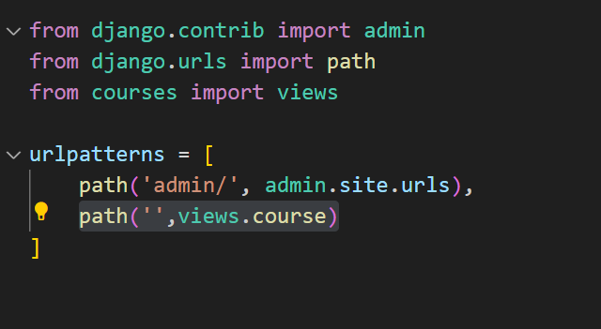
Final output show:
Go to urls.py- import- (from courses import views)
path('',views.course)
Important extention- sqlite viewer, python, auto rename tag, prettier code.

Slide 19
Thank You…

